Slide 1
Implementing a Compelling User Interface in React
Setting the scene
Implementing routing
Displaying all destinations
Displaying one destination
React demo: demo-full-stack-client
To install: npm install
To run: npm start

Slide 2
1. Setting the Scene
Example application
Application characteristics

Slide 3
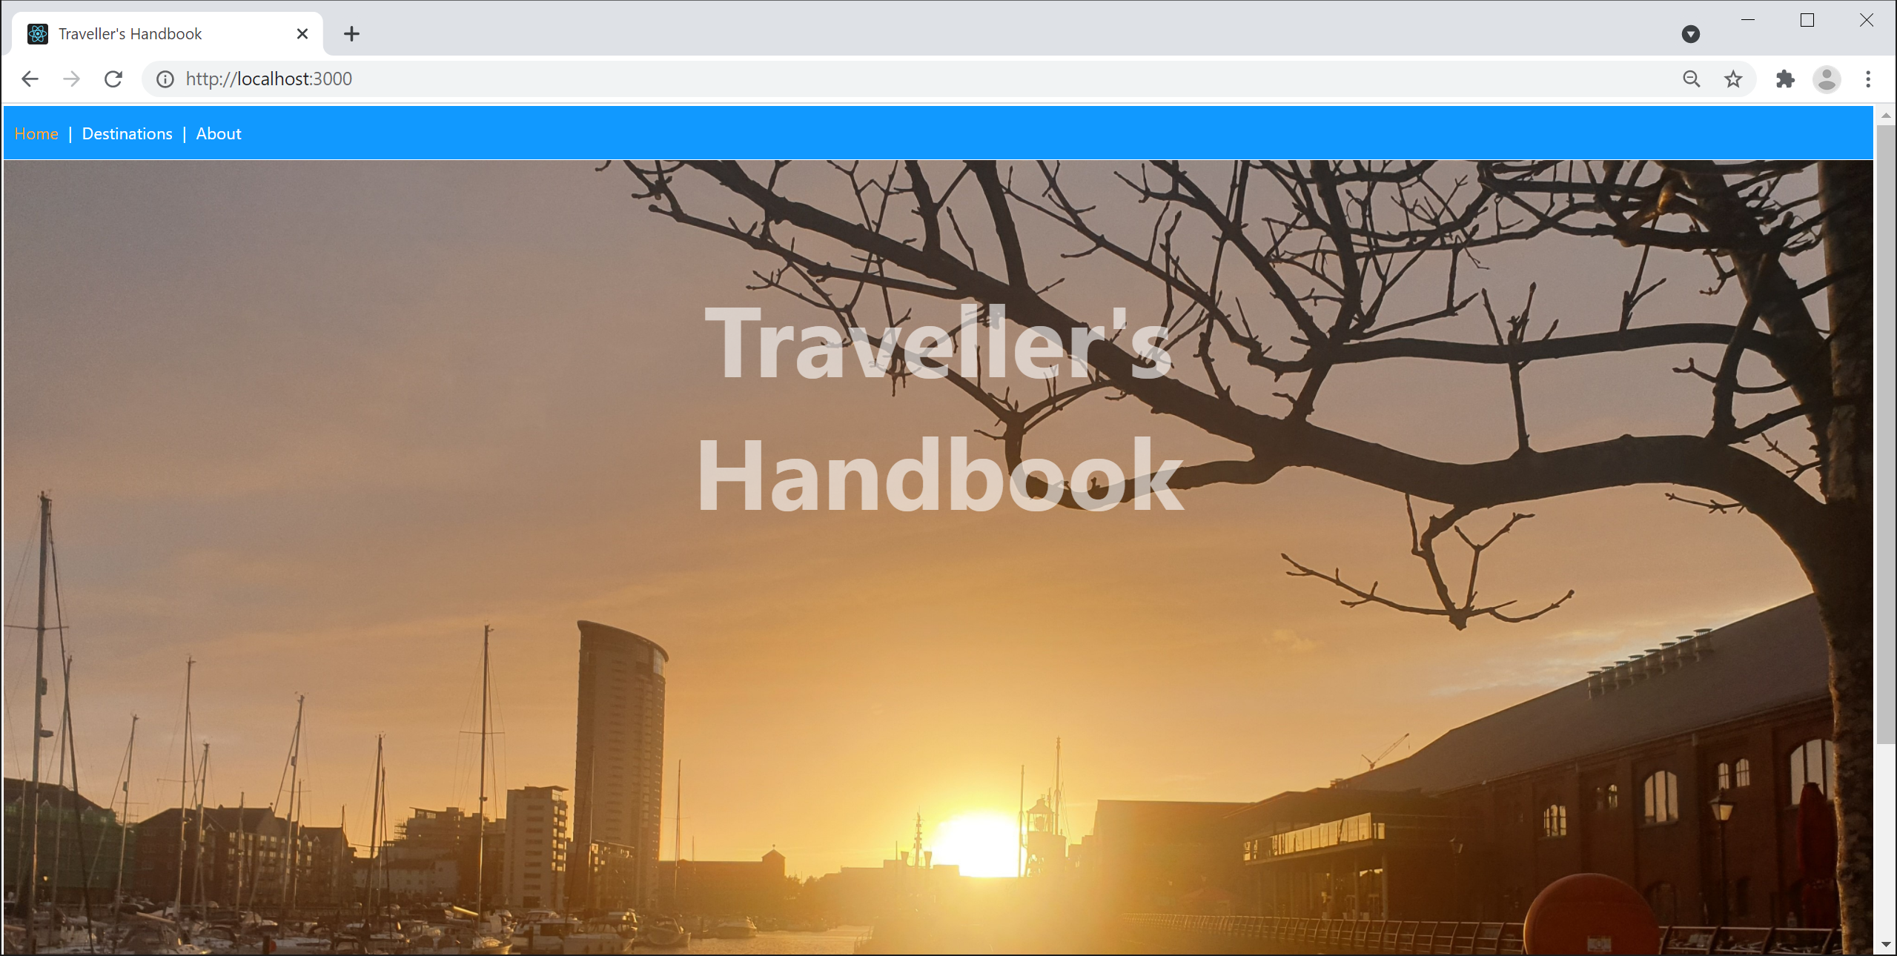
Example Application
In this chapter we'll explore a complete UI in React
See demo-full-stack-client
3

Slide 4
Application Characteristics
The application has several key characteristics:
Single-page application (SPA)
Compelling UI
Realistic application structure
Utilizes contemporary React patterns and techniques
Interacts with Spring Boot back-end via REST
4

Slide 5
2. Implementing Routing
React and single-page applications
Supporting routing in React
Defining a router table
Defining a menu

Slide 6
React and Single-Page Applications
React has excellent support for implementing SPAs
Define an App component that always remains resident
Define multiple sub-components, which can be swapped in and out of the App component
Each sub-component maps to a logical URL
This is called "routing"
To display a different sub-component in the browser, simply navigate to the URL for that sub-component
6

Slide 7
Supporting Routing in React
Add these dependencies in package.json:
Wrap your App component in <BrowserRouter>:
"dependencies": {
"react-router-dom": "^5.2.0",
"@types/react-router-dom": "^5.1.7",
…
}
React Router
React Router TypeScript declarations
package.json
ReactDOM.render(
<BrowserRouter>
<App />
</BrowserRouter>,
document.getElementById('root')
)
index.tsx
7

Slide 8
Defining a Router Table
Define a router table as follows, typically in App:
export default function App() {
return ( … … …
<Switch>
<Route exact path="/" >
<Home />
</Route>
<Route path="/destinations">
<Destinations />
</Route>
<Route path="/destination/:id">
<Destination />
</Route>
…
<Route path="*" >
<PageNotFound />
</Route>
</Switch>
)
}
App.tsx
8

Slide 9
Defining a Menu
It's common to define some kind of menu component
Use <NavLink> to create links to your routes
You typically display the menu in your App component
See App.tsx
export default function Menu() {
return (
<nav>
<NavLink exact to="/">Home</NavLink>&nbsp;|&nbsp;
<NavLink to="/destinations">Destinations</NavLink>&nbsp;|&nbsp;
<NavLink to="/about">About</NavLink>
</nav>
)
}
Menu.tsx
9

Slide 10
3. Displaying all Destinations
Overview
How the Destinations component works
Using React state storage
Using React effect hooks
Displaying parameterized route links

Slide 11
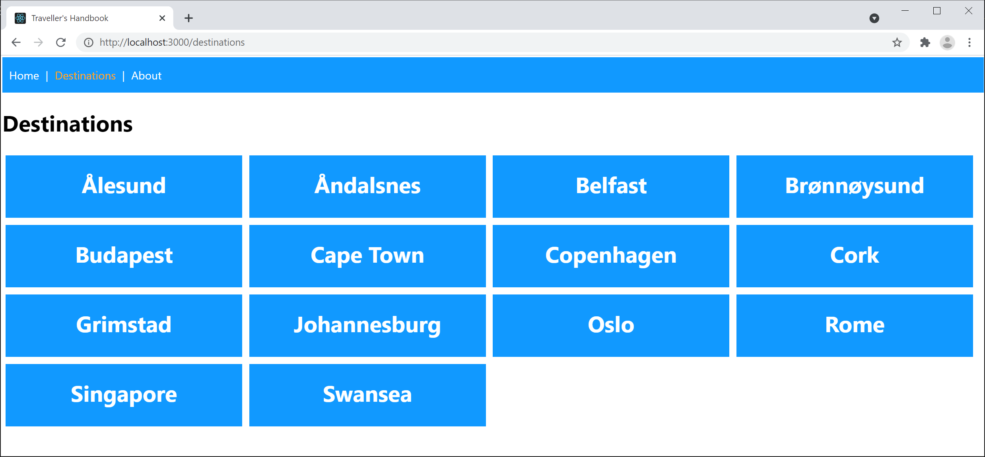
Overview
Browse to the /destinations location
The Destinations component is activated
11

Slide 12
How the Destinations Component Works
The Destinations component gets its destinations data via REST
This is asynchronous, so it could take a while…
When the destinations data finally arrives:
Store the data in React state
Causes React to automatically re-render the component
12

Slide 13
Using React State Storage
You can't store state (data) in a local variable
Local variables disappear at the end of the function
Instead you must use React.useState()
React.useState() returns:
A reference to state data maintained by React
A function you must call if you change the state (this tells React to re-render your component)
let [destinations, setDestinations] = React.useState<Array<any>>([])
Destinations.tsx
13

Slide 14
Using React Effect Hooks
You don't need to get data on every render
Just get data after first render, and store it in React state
If you have work you want to do after a component is rendered, call React.useEffect()
Pass in a lambda, specifying the work you want to do
Pass in a dependency array
React.useEffect(() => {
RestClient.getDestinations()
.then(destinations => setDestinations(destinations))
}, [])
Destinations.tsx
14

Slide 15
Displaying Parameterized Route Links
The Destinations component displays hyperlinks for all the destinations, parameterized by id
E.g. destination/1
index.css defines styles so the links are uber-cool!
{destinations.map((dest: any, i: number) =>
<Link to={`destination/${dest.id}`} key={i} className='blockLink'>{dest.place}</Link>
)}
Destinations.tsx
.blockLink { … … … }
.blockLink:hover { … … … }
index.css
15

Slide 16
4. Displaying one Destination
Overview
How the Destination component works
Component modular decomposition
Defining and using custom hooks

Slide 17
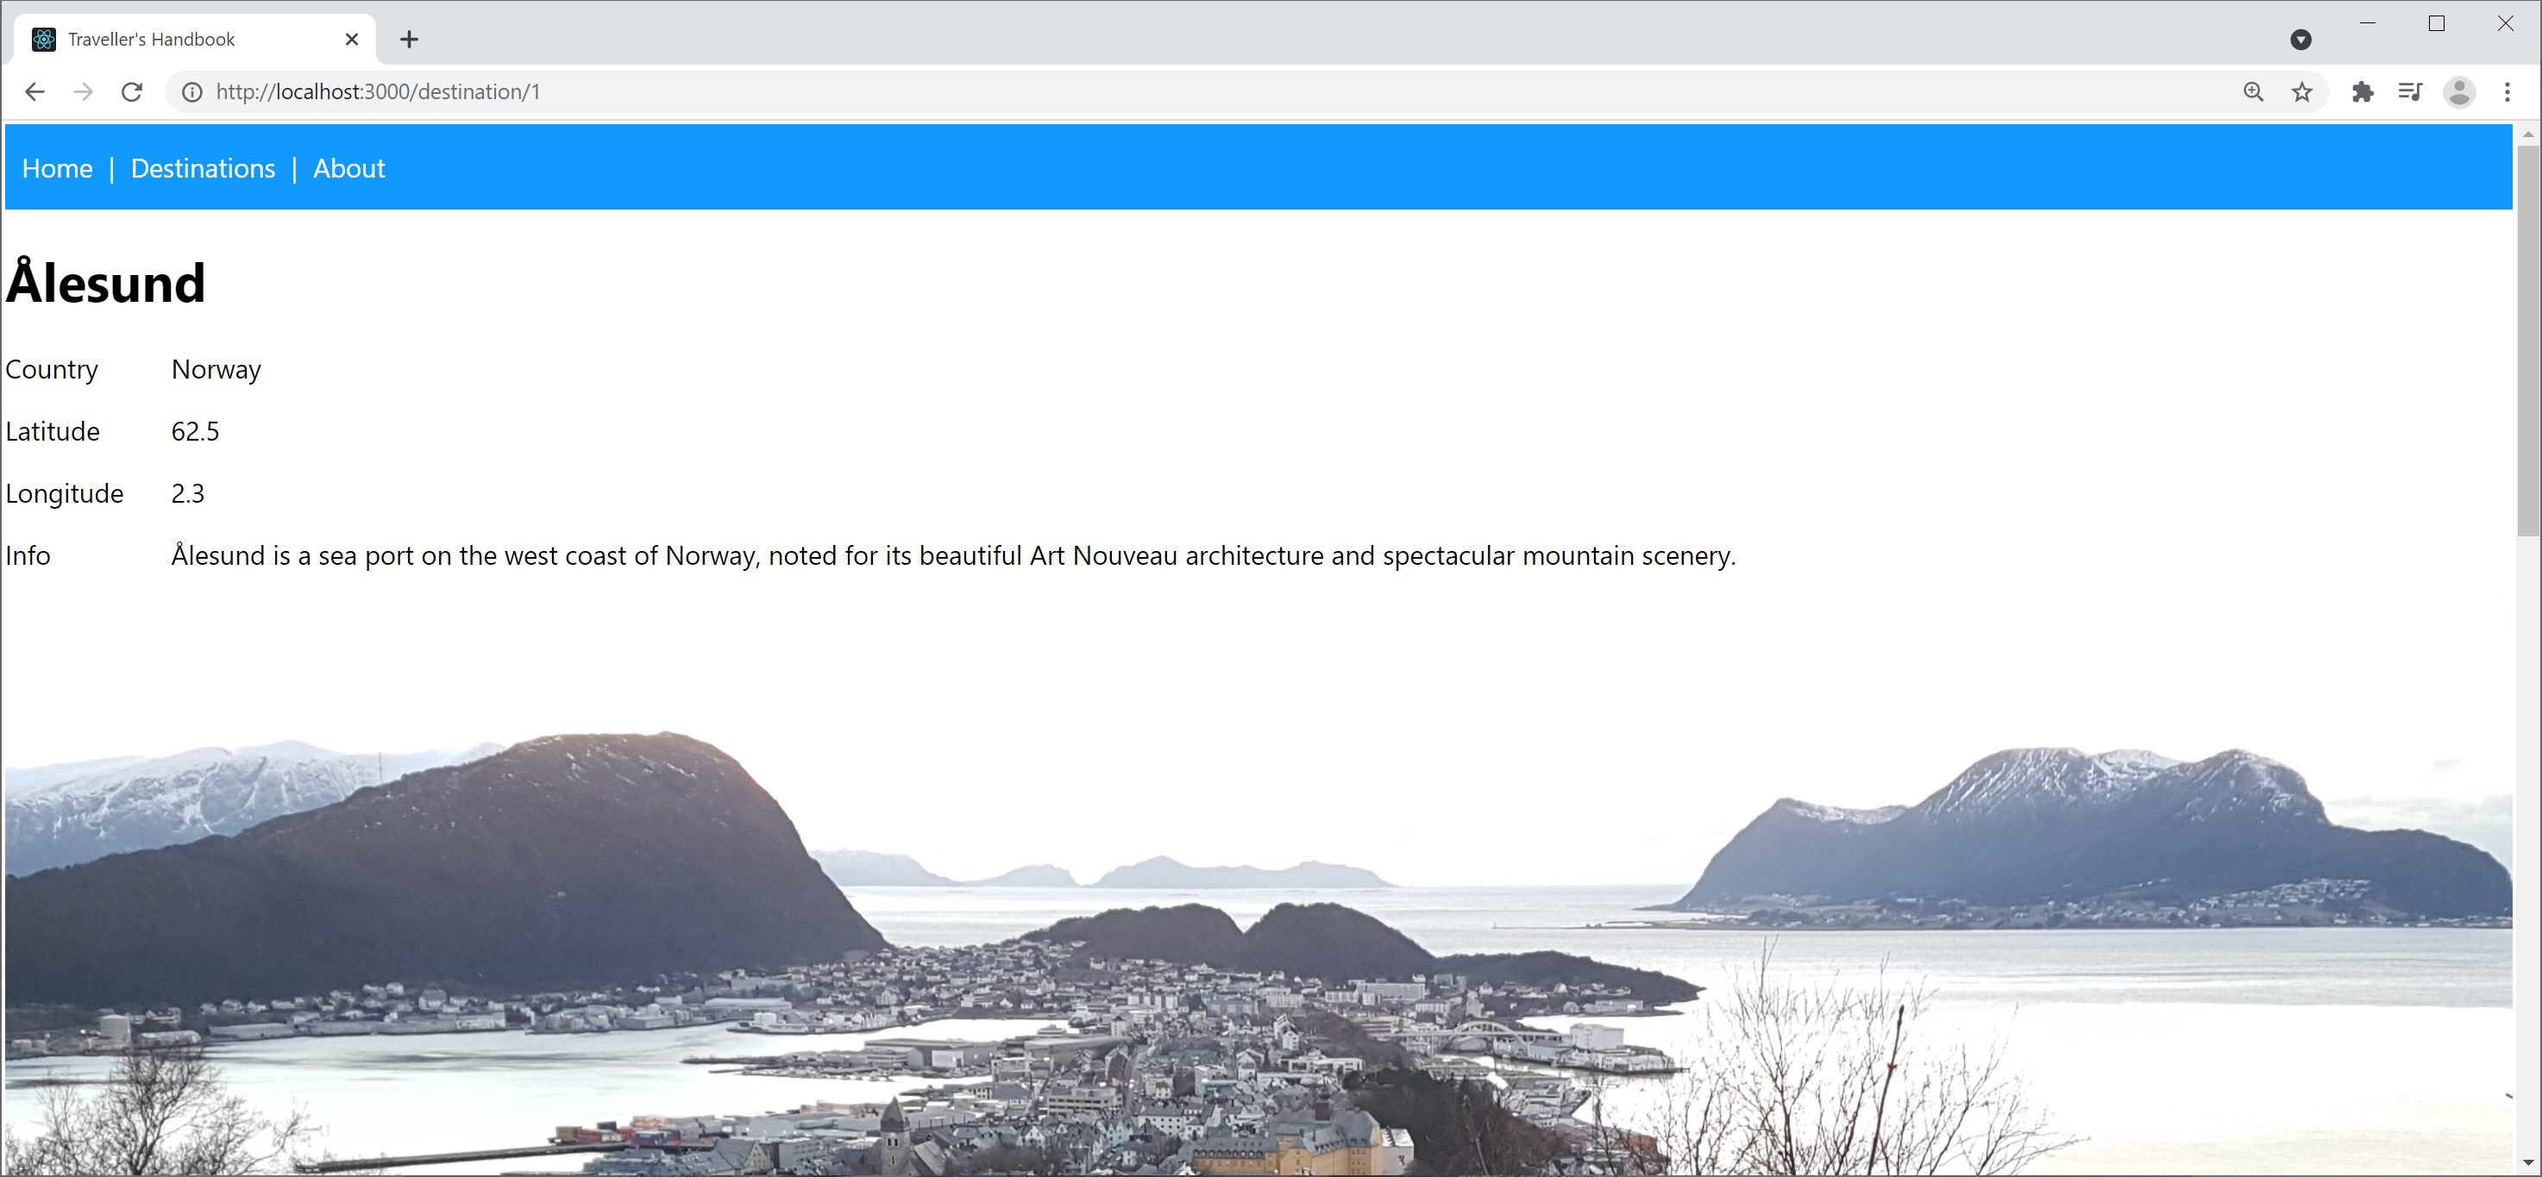
Overview
Click one of the destination links
The Destination component is activated, with an id
The component displays details for that destination
17

Slide 18
How the Destination Component Works
The Destination component gets the id parameter from the location URL (see the routing table)
The component then gets data for that destination, and stores the data in React state
let {id} : any = useParams()
Destination.tsx
let [destination, setDestination] = React.useState<any>(undefined)
React.useEffect(() => {
RestClient.getDestination(id)
.then(destination => setDestination(destination))
.catch(err => alert(err))
}, [id])
Destination.tsx
18

Slide 19
Component Modular Decomposition
The Destination component is quite complex
So we render it in 2 separate sub-components
<React.Fragment>
<DestinationDetails {...destination} />
<DestinationReviews {...destination} />
</React.Fragment>
Destination.tsx
19

Slide 20
Defining and Using Custom Hooks (1 of 2)
The DestinationReviews component makes use of "custom hooks" to simplify rendering
A custom hook is a helper function
Contains reusable logic to simplify components
Function name conventionally starts with use
function DestinationReviews(destination: any) {
return (
<React.Fragment>
{useReviewsMarkup(destination)}
{useAddReviewFormMarkup(destination)}
</React.Fragment>
)
}
Custom hook
Custom hook
Destination.tsx
20

Slide 21
Defining and Using Custom Hooks (2 of 2)
The addReviewFormMarkup() custom hook displays a <form> where the user can add a review
When the user submits the form, the function:
Collates the review details into an object
Sends the review object to the server, via a REST API
Adds the review to the client-side destination object
Causes the component to re-render (via a state change)
21

Slide 22
Summary
Setting the scene
Implementing routing
Displaying all destinations
Displaying one destination

